Slide 1


EcoPrompt: Inspiring Sustainability Through AI-Generated Prompts
Team Members:
Athiraj V.S (2020115016),
Siva Vignesh S (2020115086),
Someshwar J (2020115088)
Under the Guidance of
Dr. M. Deivamani, Assistant Professor.

Slide 2
Problem Statement
The carbon footprint of AI is affected by the complexity of its tasks.
This project focuses on creating a Prompt Generation Model (PGM) for image generation, aiming to convert user inputs into efficient prompts.
The goal is to reduce the computational workload of the LLM while maintaining image quality and relevance.

Slide 3
Literature Survey
Sno | Title | Journal/Conference | Methodologies/approaches | Pros | Cons
[1] | Graph of Thoughts: Solving Elaborate Problems with Large Language Models | CHI Conference on Human Factors in Computing Systems Extended Abstracts (2023) | Graph of thoughts | Efficient decomposition, versatile graph transformations. | Context limitation, learning curve.
[2] | Beyond Chain-of-Thought, Effective Graph-of-Thought Reasoning in Large Language Models | Advances in Neural Information Processing Systems 31: Annual Conference on Neural Information Processing Systems (2023) | Graph of thoughts, Chain Of Thought | Realistic thought modeling. Complex reasoning. | Novelty, task-dependence.
[3] | DreamStyler: Paint by Style Inversion with Text-to-Image Diffusion Models | Proceedings of the IEEE/CVF Conference on Computer Vision and Pattern Recognition (2023) | Text to Image synthesis and style transfer | Flexibility to accommodate a range of style references, the avoidance of overfitting. | limitations within the intricate context of artistic expression

Slide 4
Literature Survey
Sno | Title | Journal/Conference | Methodologies/approaches | Pros | Cons
[4] | Deliberate Problem Solving with Large Language Models | Proceedings of the ACM/IEEE International Symposium on Computer Architecture, (2023) | Tree of thoughts | Generality Modularity Adaptability Convenience | LM Quality Resource Intensive
[5] | Multimodal Chain-of-Thought Reasoning in Language Models | Proceedings of 2021 Conference of the Association for Computational Linguistics (ACL) (2023) | Multimodal Chain-of-Thought Reasoning | Multimodal approach and generate better rationales for answer inference | Limited Context Integration
[6] | Pre-trained Language Model with Prompts for Temporal Knowledge Graph Completion | CHI Conference on Human Factors in Computing Systems Extended Abstracts (2023) | Re-trained Language Model with Prompts for TKGC | Improved TKGC accuracy | Limited Temporal Awareness, Insufficient Contextualization

Slide 5
Literature Survey
Sno | Title | Journal/Conference | Methodologies/approaches | Pros | Cons
[7] | Natural Language is All a Graph Needs | Proceedings of the IEEE conference on computer vision and pattern recognition (2023) | InstructGLM that uses natural language instructions to fine-tune a large language model for graph learning | Fine-tune a large language model for graph learning include its simplicity, efficiency, and scalability, | Handling complex graph structures and the need for further validation on larger datasets.
[8] | DreamBooth: Fine Tuning Text-to-Image Diffusion Models for Subject-Driven Generation | Proceedings of the IEEE conference on computer vision and pattern recognition (2023) | Subject-driven generation, which allows users to synthesize novel renditions of a subject based on personalized generative priors | Ability to generate personalized images of a subject in different contexts | Difficulty in controlling fine-grained details of subject appearance using prompts

Slide 6
Literature Survey
Sno | Title | Journal/Conference | Methodologies/approaches | Pros | Cons
[9] | Prompt Tuning for Graph Neural Networks | Conference paper at ICLR (2022) | Graph Prompt | Efficient adaptation method | Missing Evaluation
[10] | Self-Consistency improves chain of thought reasoning in language models | Conference paper at ICLR (2022) | Self-consistency method, Chain-of-thought prompting | Improves accuracy significantly and provides rationales and uncertainty estimates | Language models can generate incorrect or nonsensical reasoning paths
[11] | P-Tuning v2: Prompt Tuning Can Be Comparable to Fine-tuning Universally Across Scales and Tasks | International Conference on Machine Learning (ICML) (2022) | Prompt Tuning, empirical analysis. | Universality, Simplicity, and reduced training time and memory cost compared to fine-tuning. | Performance trade-offs. Limited adoption. Complexity.

Slide 7
Literature Survey
Sno | Title | Journal/Conference | Methodologies/approaches | Pros | Cons
[12] | Sustainable AI: Environmental Implications, Challenges and opportunities | Proceedings of the ACM/IEEE International Symposium on Computer Architecture (2021) | Holistic analysis. Cycle, footprint. Opportunities, development. | Carbon reduction, savings, perception. | Performance trade-offs. Limited adoption. Complexity.
[13] | Putting Humans in the Natural Language Processing Loop: A Survey | Conference on Empirical Methods in Natural Language Processing and the International Joint Conference on Natural Language Processing (2021) | Active learning, Crowdsourcing, Interactive machine learning | Performance Boost Interpretability Bias Mitigation Collaboration | Time & Cost Feedback Quality Feedback Bias
[14] | The Future is Big Graphs! A Community View on Graph Processing Systems | Communications of the ACM journal (2020) | Model Checking Theorem Proving Indexing Sampling Reproducibility | Complex Data Handling Relationship Insights Versatile Applications | Computational Cost Scalability Challenges Expertise Required

Slide 8
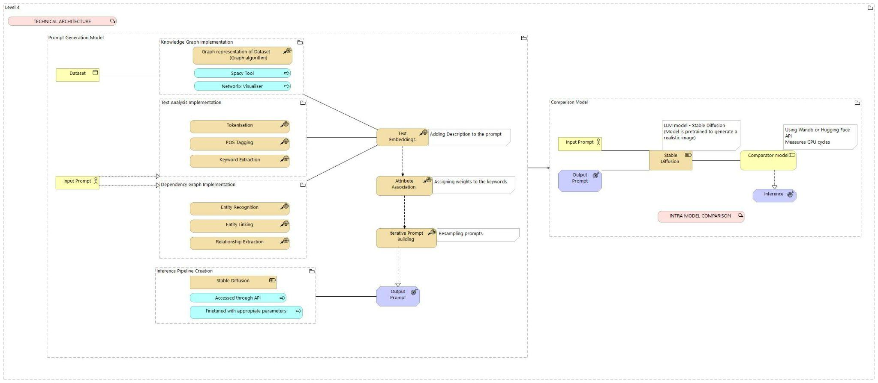
Technical Architecture

Slide 9
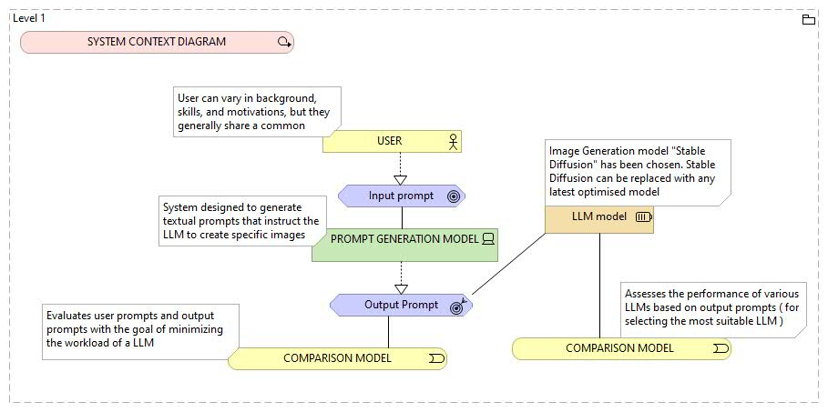
Detailed Architecture
System Context Diagram: People and software systems that are directly connected to the software system in scope.

Slide 10
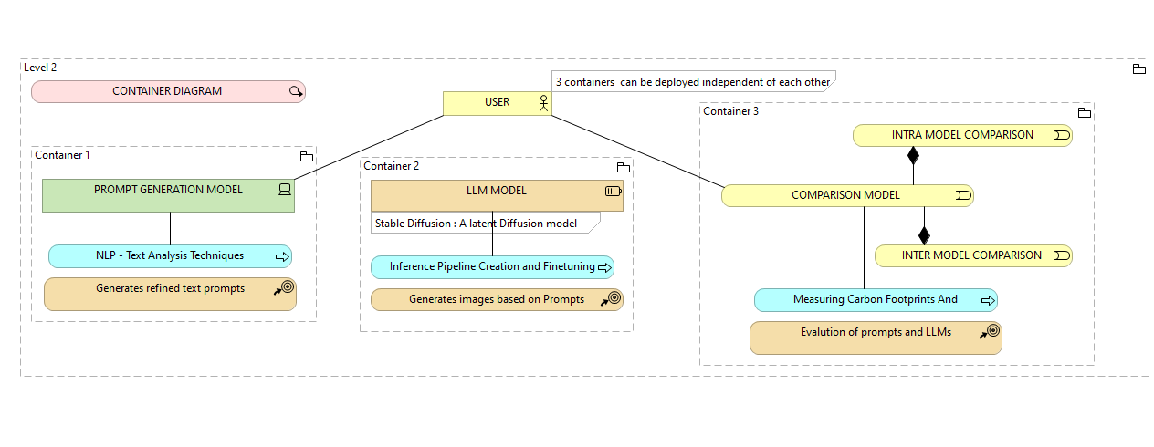
Detailed Architecture [Contd.]
Container Diagram: A container is a separately runnable/deployable unit (e.g. a separate process space) that executes code or stores data.

Slide 11
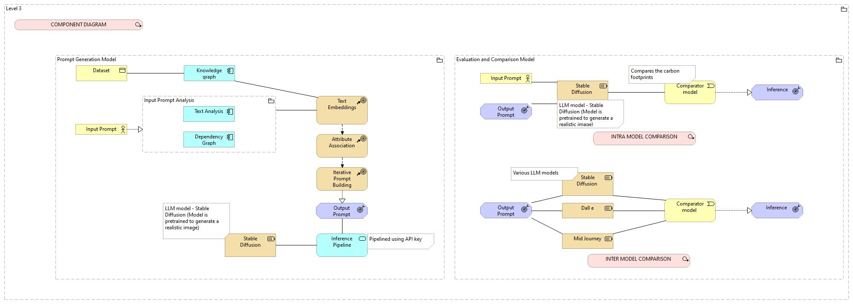
Detailed Architecture [Contd.]
Component Diagram: Decompose each container further to identify the major structural building blocks and their interactions.

Slide 12
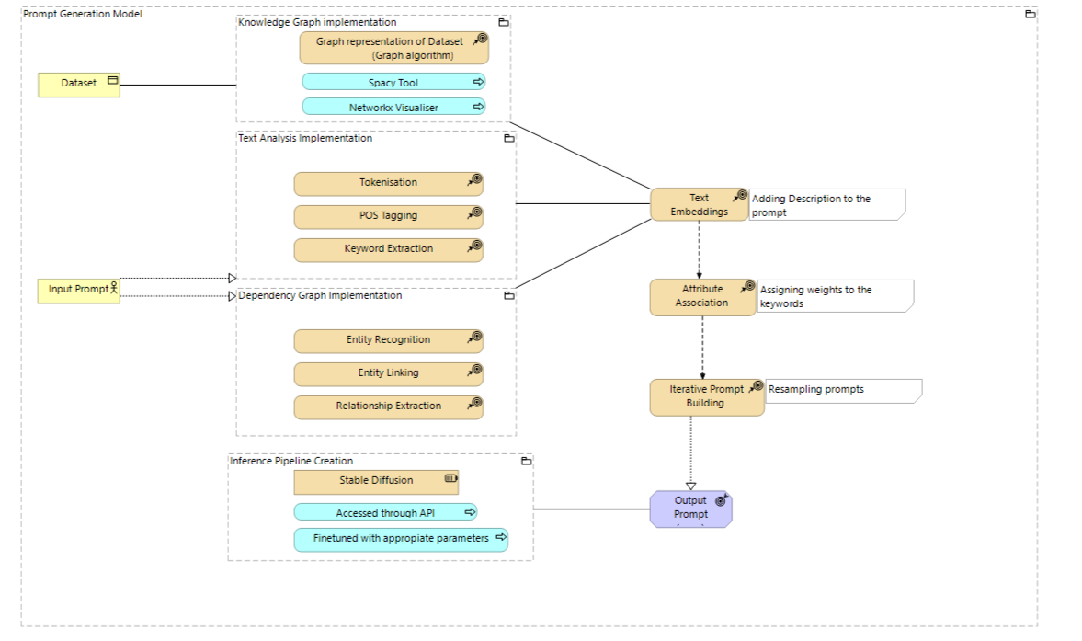
Detailed Architecture [Contd.]
Code Diagram: zoom in to each component to show how it is implemented as code

Slide 13
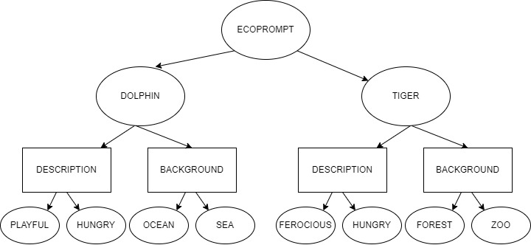
Module Description
Knowledge Graph Implementation Input: Knowledge Base (JSON) Output: Graph This module uses the given knowledge base (data), and puts that into a Knowledge Graph which is being the main component of GOT. Once the Knowledge Graph is built, the corresponding attributes and relations are taken by Graph Traversal.

Slide 14
Knowledge Graph Implementation - Contd.
Class Node: data = None children = [] Function Node(data): self.data = data self.children = [] Function add_child(child): self.children.append(child) Function display(): Return self.data End Class | Class Graph: Function add_edge(parent, child): parent.add_child(child) Function get_children(node): Return node.children Function find_node(target): For node in self.nodes: If node.data equals target: Return node Return None End Class

Slide 15
Module Description [Contd.]
Tokenization: Input : User Input Output : tokens Tokenization is the process of dividing a text or sentence into individual units or "tokens," such as words, phrases, or symbols, to facilitate natural language processing tasks. Tokenization can involve splitting text on whitespace, punctuation, or specific patterns, making it essential for text processing in various language-related applications. | Code Snippet: sentence = "user_input" tokens = [] words = sentence.split(" ") for word in words: tokens.append(word) for token in tokens: print(token)

Slide 16
Module Description [Contd.]
POS Tagging: Input: Token Output: POS Tagged tokens Parts of Speech (POS) tags are assigned to each token. POS tags are labels that categorize each word in the prompt - whether it's a noun, verb, adjective, or any other part of speech This step adds a layer of linguistic intelligence to the analysis | Code Snippet : import nltk sent = "user_input" words = tokenize(sent) pos_tags =nltk.pos_tag (words) for word, pos_tag in pos_tags: print pos_tag

Slide 17
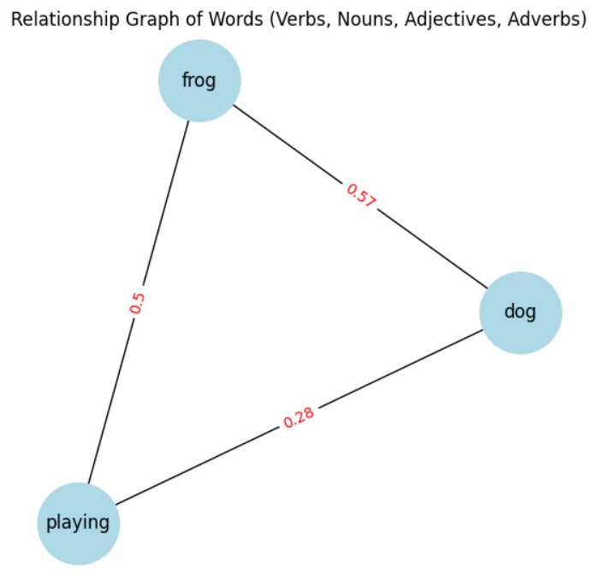
Module Description [Contd.]
Attribute Association (tentative)
Input: POS Tagged Tokens
Output: Weighed tokens
Identify and link attributes to entities in text data.
It provides more detailed and structured understanding of the entities and their relationships.

Slide 18
Attribute Association [Contd.]
Extracts words of interest Extracting the specific words in a text that are considered important or relevant for a particular task or analysis. Calculate the Relationship Finding the importance and relationship between words in the sentence using similarity function. Dependency Graph From the above generated weights and relationship between words, generate the graph using spacy | Code Snippet: for token in doc: if token.pos_ in ("VB", "NN"): words_of_interest.append(token.text) G.add_nodes_from(words_of_interest) for word1 in words_of_interest: for word2 in words_of_interest: if word1 != word2: similarity = nlp(word1).similarity(nlp(word2)) G.add_edge(word1, word2, weight=similarity) words_weight[word1] = 1 + round(similarity, 2) words_weight[word2] = 1 + round(similarity, 2)

Slide 19
Module Description [Contd.]
Text Embeddings:
Subject Description:
The knowledge graph is traversed for each subject and their corresponding subject Description is appended to the subject.
Background inclusion:
The knowledge graph is traversed for each subject and their corresponding background appended to the prompt.
Sentiment analysis:
Sentiment analysis is the process of examining and understanding
the context of a given sentence or text.

Slide 20
Module Description - [Contd.]
Code Snippet:
def setup(self):
if self.device is None:
self.device = get_default_device()
self.pipeline = StableDiffusionPipeline.
from_pretrained(self.default_checkpoint)
self.pipeline.to(self.device)
def _call_(self, prompt):
if not self.is_initialized:
self.setup()
generated_images = [] generated_images.append(self.pipeline
(prompt))
return [self.pipeline(prompt).images
return [image.images[0] for image in generated_images]
Inference Pipeline Creation
Creating an inference pipeline typically refers to setting up a sequence or workflow of processes that allow you to make predictions or inferences using machine learning models.
The models that have been run and pushed to hugging face have been used using Inference Pipeline creation.

Slide 21
Module Description [Contd.]
Prompt Generation Model
Text generation model for generating suitable style cues given the main idea for a prompt.
It is performing tasks to fine-tune a GPT-2 language model for text generation using a custom dataset.
There are steps involving for prompt generation
Data Collection & Data Pre-Processing
Custom Tokenizer
Configuring Model For Training
Training & Model Fine-Tuning
Text Generation

Slide 22
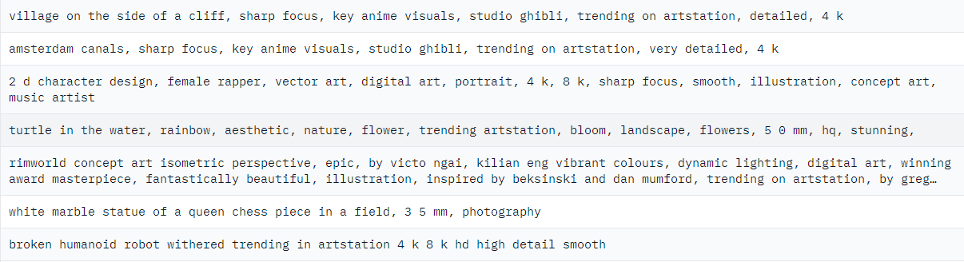
Module Description [Contd.]
Collected from HUGGING FACE
Data Preparation
Loading a custom training dataset.
Tokenizing the text data using a pre-trained tokenizer (old_tokenizer) and preparing it for training.

Slide 23
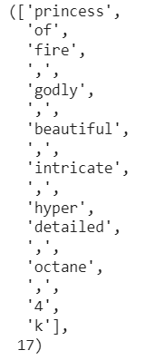
Prompt Generation Model [Contd.]
Custom Tokenizer Training
Training a new custom tokenizer from the training dataset with an extended vocabulary size.
Saving the custom tokenizer for future use.
CODE SNIPPET
training_dataset = load_training_dataset()
custom_tokenizer = initialize_custom_tokenizer(initial_vocab)
training_corpus = []
for example in training_dataset:
training_corpus.append(example["prompt"])
custom_tokenizer.train(training_corpus)

Slide 24
Prompt Generation Model [Contd.]
Configuring Model for Training Tokenizing the training dataset using the new custom tokenizer to create tokenized input sequences. Configuring a GPT-2 language model to match the tokenizer's vocabulary size and context length. | Code Snippet tokenized_training_dataset = custom_tokenizer.tokenize(training_data) model = configure_gpt2_model(context_length, custom_tokenizer.vocab_size) prepared_data = prepare_data(tokenized_training_dataset, model) training_parameters = configure_training_parameters(batch_size, learning_rate, num_epochs)

Slide 25
Prompt Generation Model [Contd.]
Model Fine-Tuning Fine-tuning the GPT-2 model on the tokenized training dataset. Setting up training parameters, such as batch size, number of epochs, and learning rate. Managing special tokens and embeddings for padding. | Code Implementation model = load_gpt2_model(model_config) data_collator = define_data_collator(tokenizer, mlm=False) trainer = initialize_trainer(model, tokenizer, data_collator, train_dataset, eval_dataset, training_args) trainer.train()

Slide 26
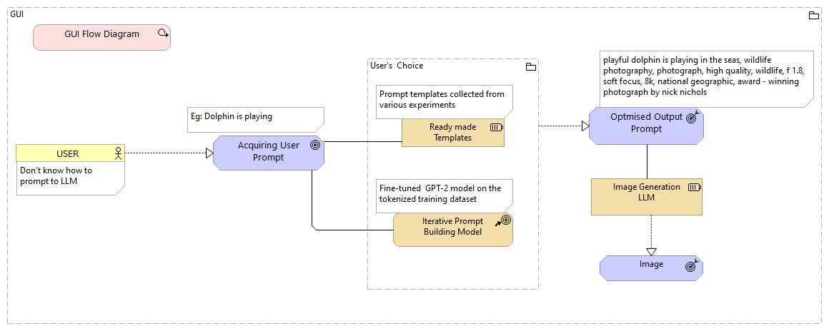
User Interaction With ECOPROMPT

Slide 27
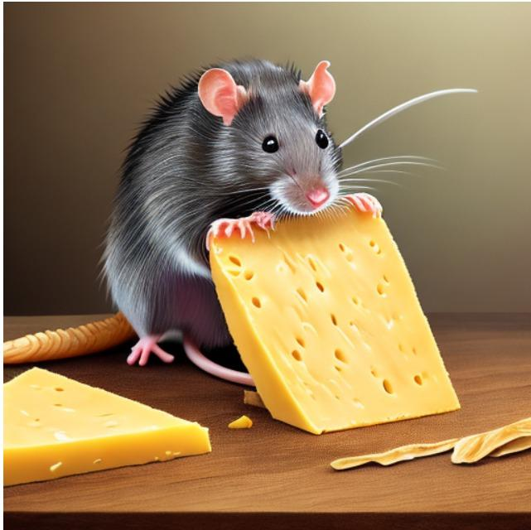
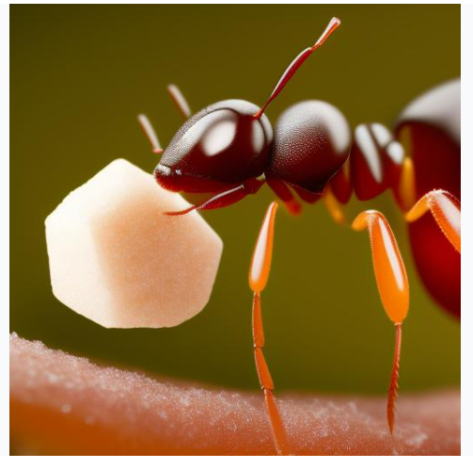
rat EATING CHEESE/(ant EATING SUGAR), 4k, photorealistic, high detail, high-resolution photograph, professional photography, ultra-detail, depth of field, focus on Canon EOS 5DD Mark II

Slide 28
Prompt and Generated Images exhibiting Actions

Slide 29
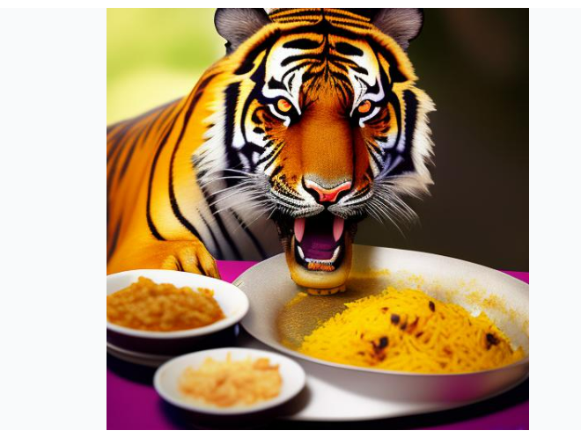
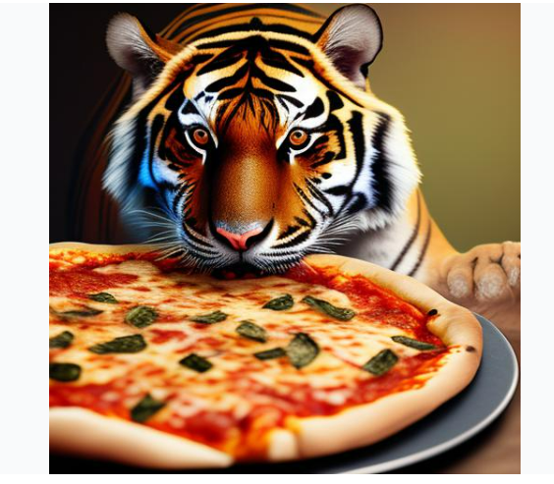
tiger eating BIRIYANI/PIZZA, 4k, photorealistic, high detail, high-resolution photograph, professional photography, ultra-detail, ultra-detail, depth of field, focus on Canon EOS 5DD Mark II, by Chris Mars, photorealism

Slide 30


rhinoceros is FLYING in the AIR, by john berkey by mark brooks, hd, hyper detailed, 4k, depth perception. com trending on artstation

Slide 31
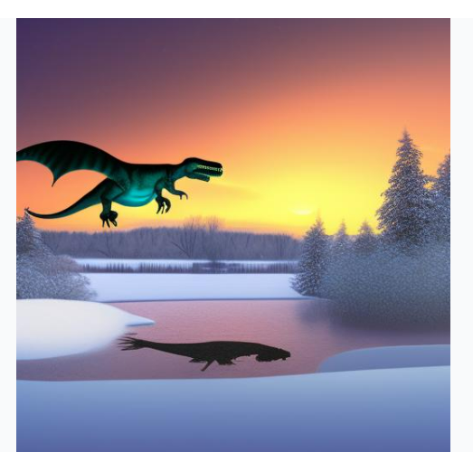

dinosaur is FLYING above a POND/CLOUDS , a huge spaceship lifts off a surfboard, by john berkey by mark brooks by jim burns by david noren, hd, hyper detailed, 4k, depth perception. com trending on artstation

Slide 32


dinosaur near a POND full of SNOW during sunset, photorealistic, cinematic, 4k, 8k render, digital render, octane render, unreal 5, artstation trending, sharp focus, high detail, illustration, photo-realistic

Slide 33
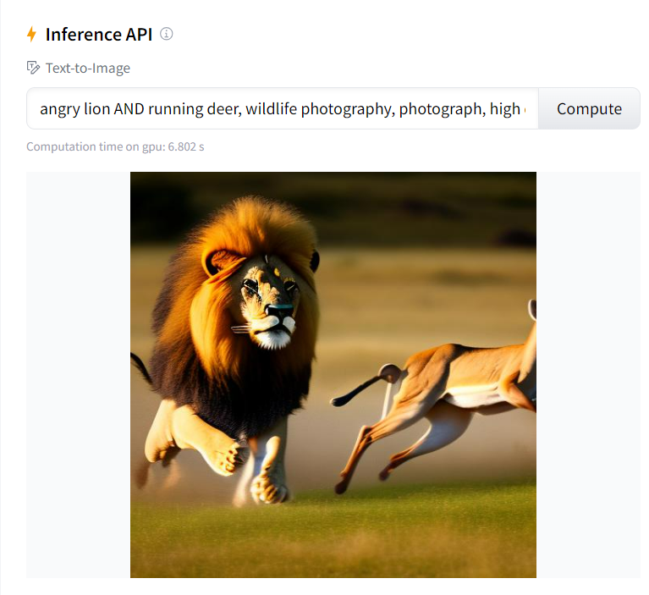
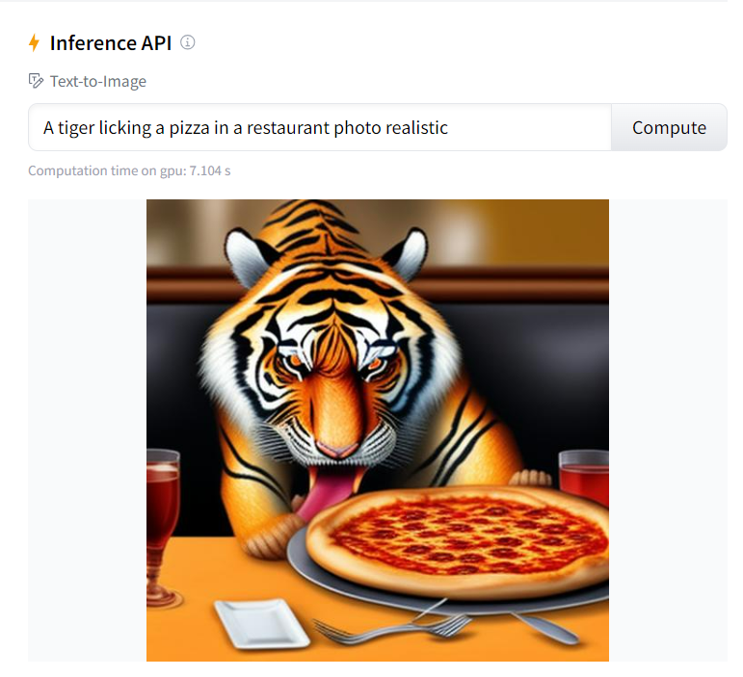

Slide 34
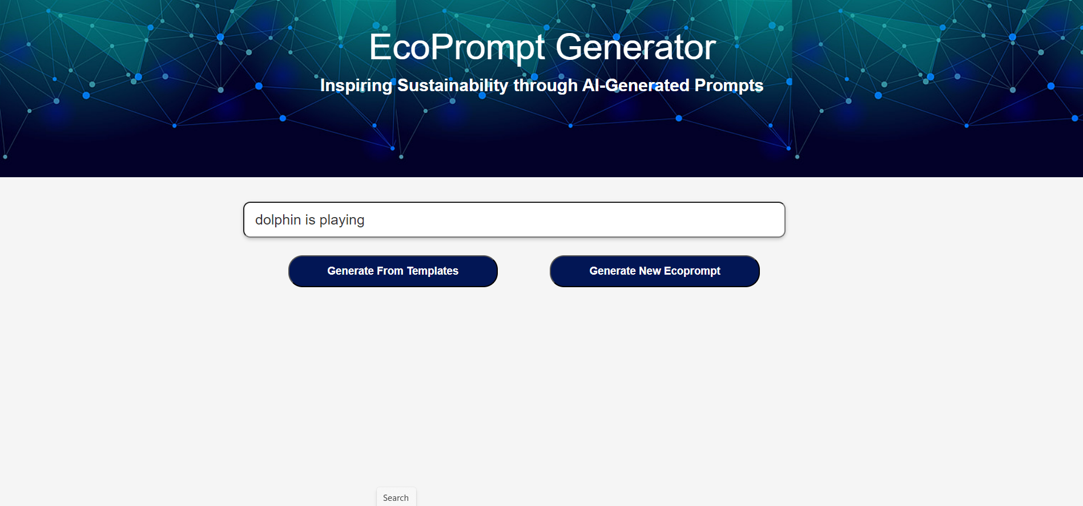

Slide 35
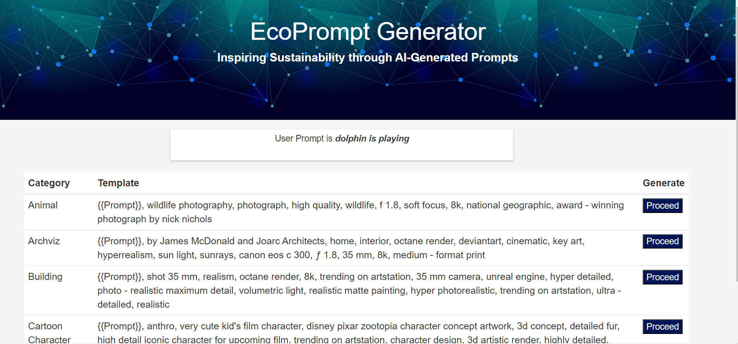

Slide 36
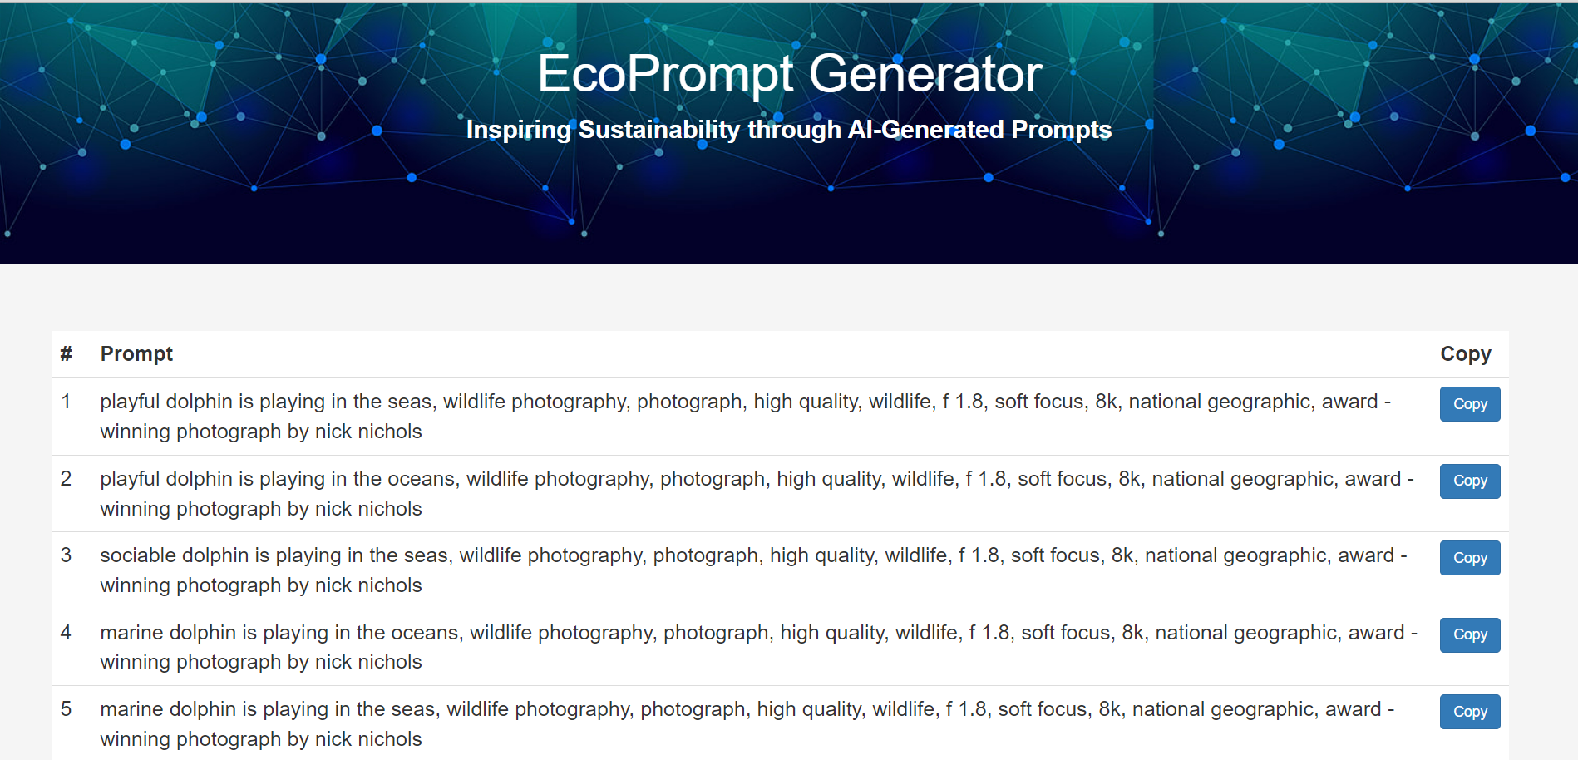

Slide 37
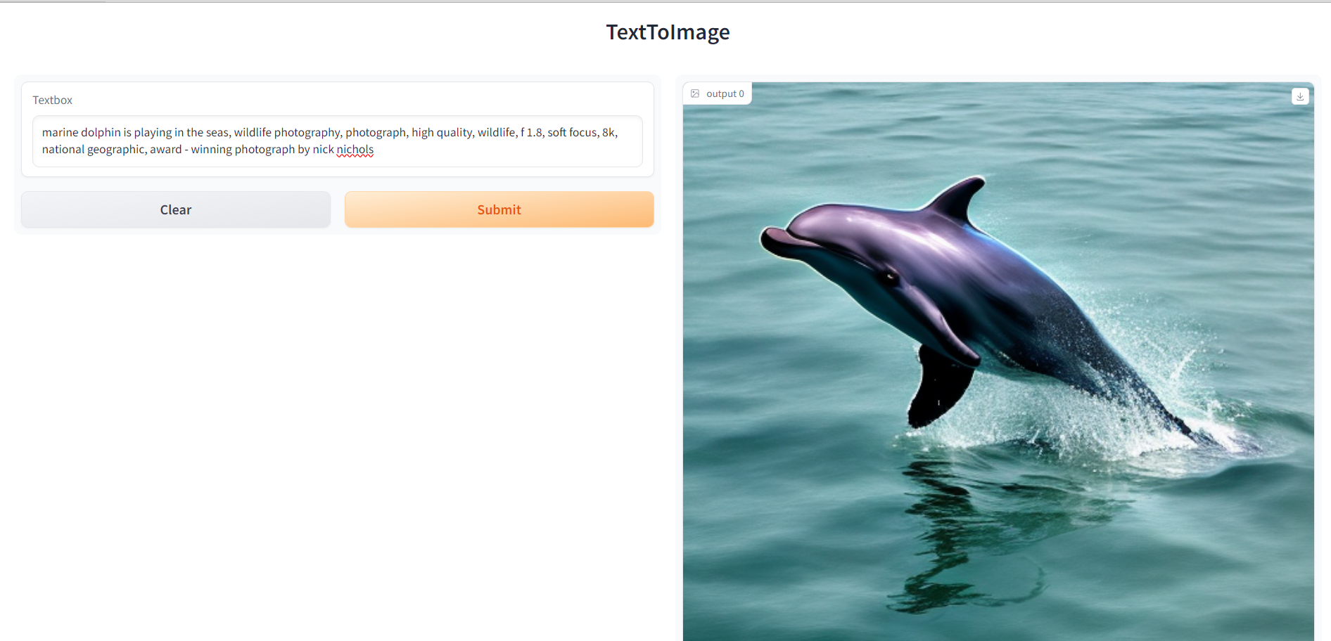
Generated Images to be continued…

Slide 38
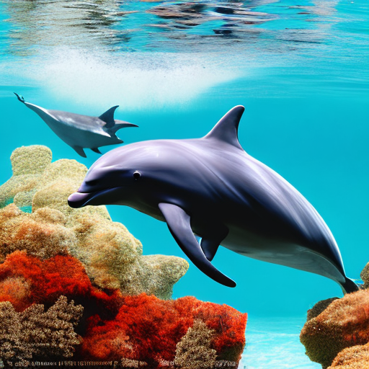
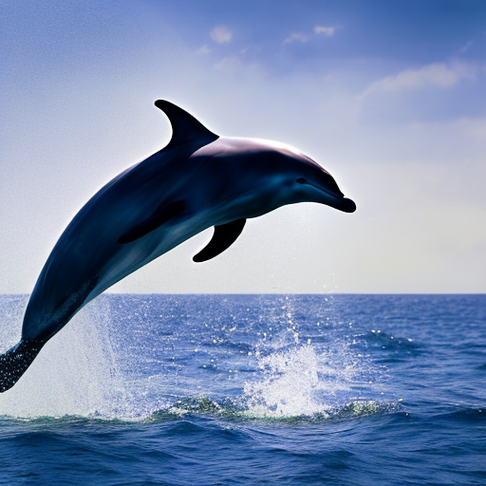

Slide 39
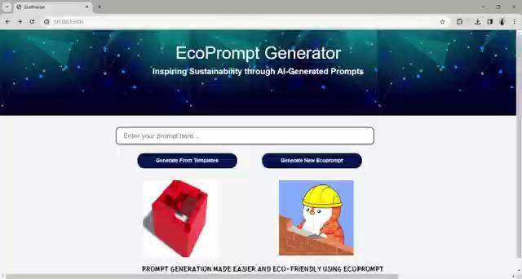
DEMO

Slide 40
GPU Cycle Measure

Slide 41
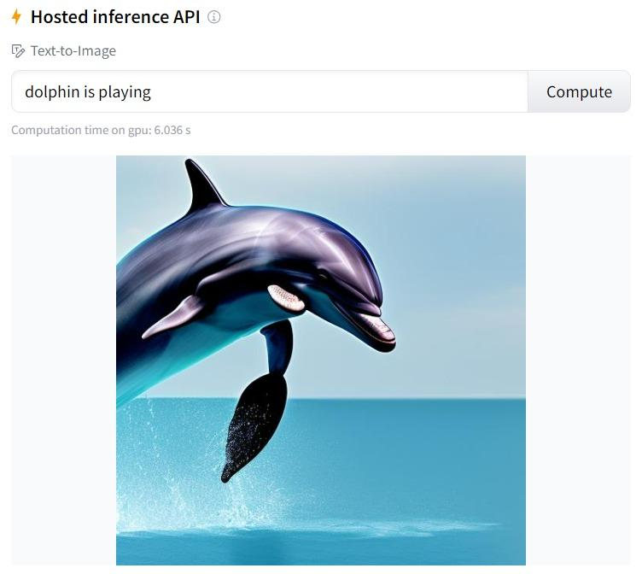
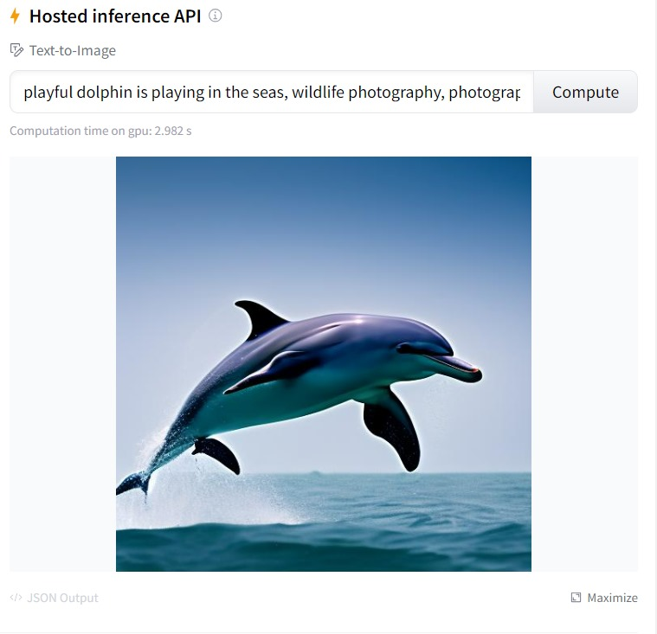
Hugginface Interface
System A
System B

Slide 42
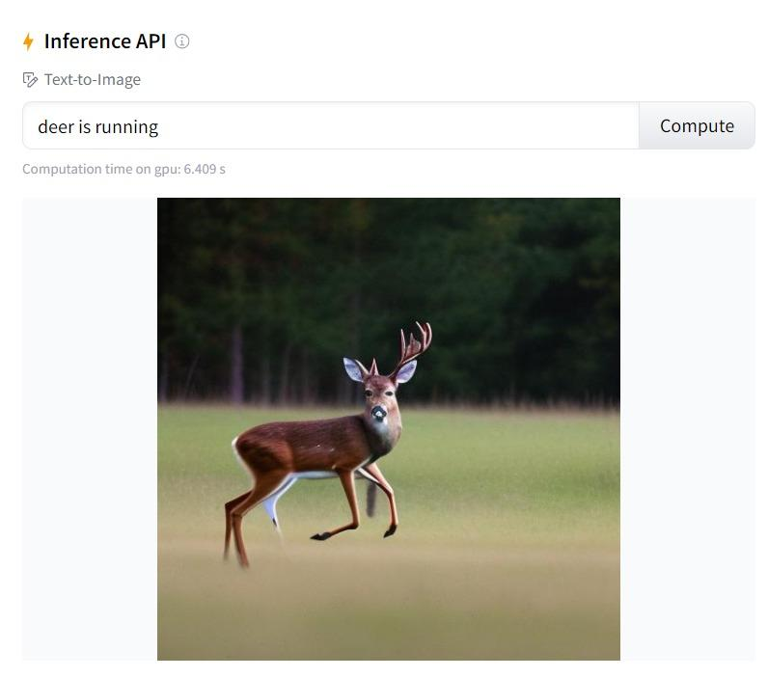
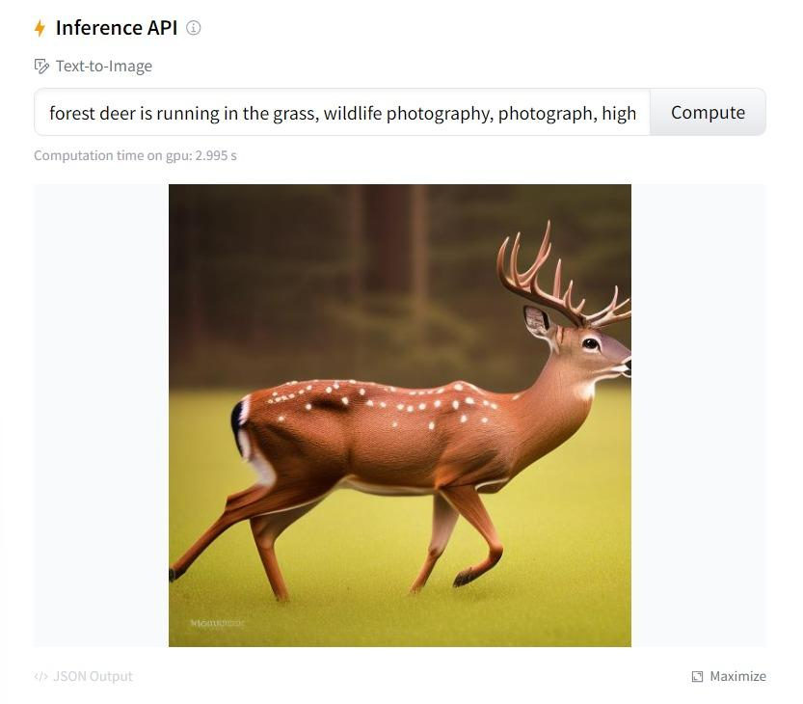
Hugginface Interface [Contd.]

Slide 43
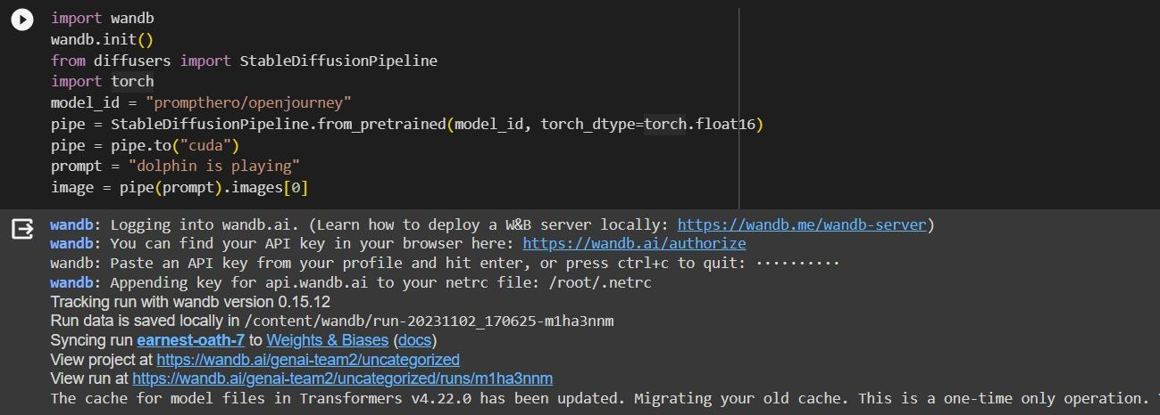
Using wandb.ai - User Prompt

Slide 44
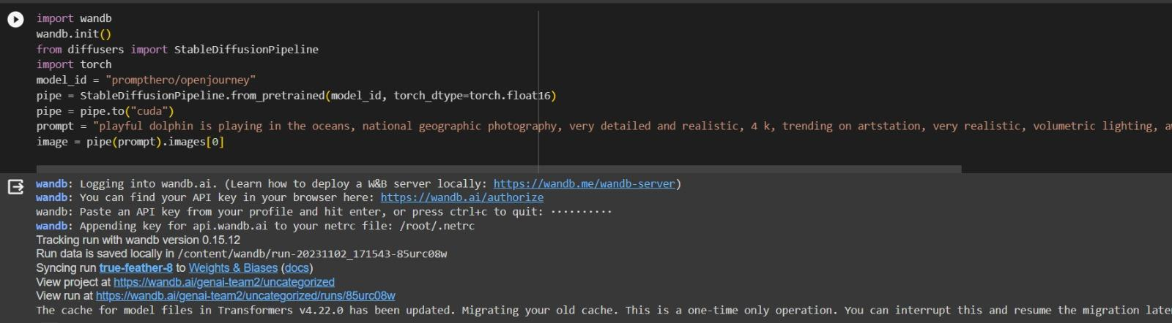
Using wandb.ai - EcoPrompt

Slide 45
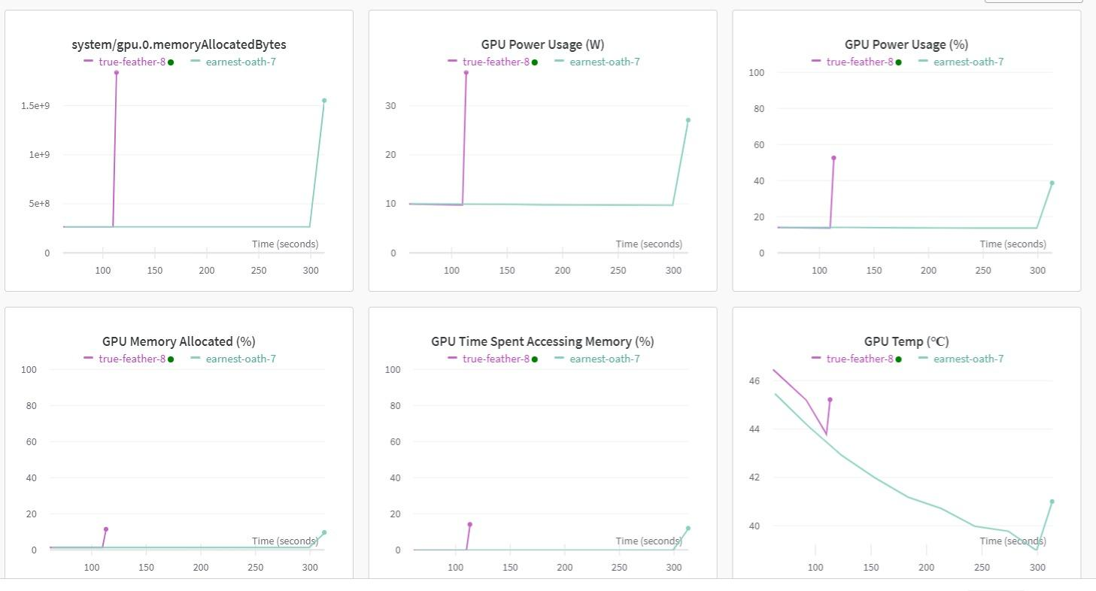
Using Wandb.ai - Output Comparison

Slide 46
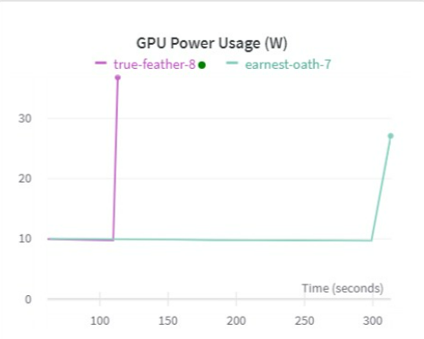
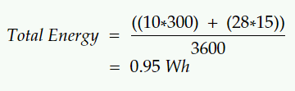
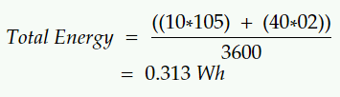
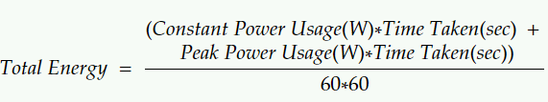
Computation [Tentative]
Formula Used | Energy Calculation (apprx.) User Prompt Eco Prompt
Power Usage (W)
Eco Prompt
User Prompt

Slide 47
THANK YOU

